Slide 1
Bank Loan Data Analysis
o Introduction
The dataset under analysis provides insights into a banking institution's loan portfolio, highlighting the total applied loan amounts, sanctions, disbursements, recoveries, and customer channels.
This report summarizes the trends and key observations from the loan funnel, distribution channels, and product types.
The dataset under analysis provides comprehensive insights into the loan processing system of a financial institution. It includes data on loan applications, sanctions, disbursements, and recoveries over time, as well as information on loan distribution through different channels and products.
The key metrics examined include:
  Total Applied Loan Amount (245K),
  Total Sanctioned Amount (213K),
  Total Disbursed Amount (196K),
  Total Recovery Amount (104K).
Additionally, the data highlights the loan funnel's efficiency, product distribution, loan recovery rates, and customer behavior across different loan channels like online, direct sales, walk-ins, and tie-ups. The information also emphasizes trends in loan applications over time and the influence of demographic factors, such as age, on loan amounts.
This analysis aims to provide valuable insights into loan performance, customer preferences, and potential areas for operational improvements.

Slide 2
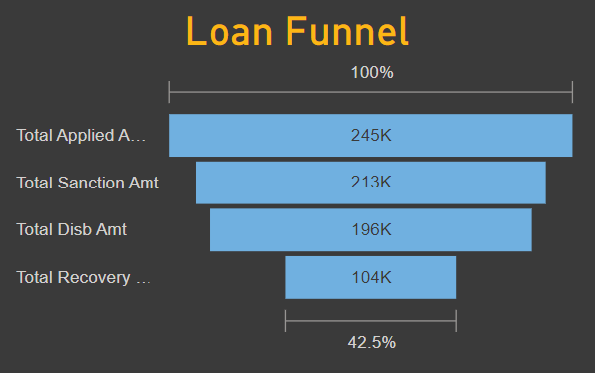
o ANALYSIS
Loan Funnel
The loan funnel shows the journey of loan applications:
  Applied Amount: 245K (100%)
  Sanctioned Amount: 213K (87%)
  Disbursed Amount: 196K (80%)
  Recovery Amount: 104K (42.5%)
This funnel illustrates that a significant portion of applied loans gets sanctioned and disbursed, but only around 42.5% of the total disbursed amount has been recovered so far. There might be a need for better loan recovery strategies.

Slide 3
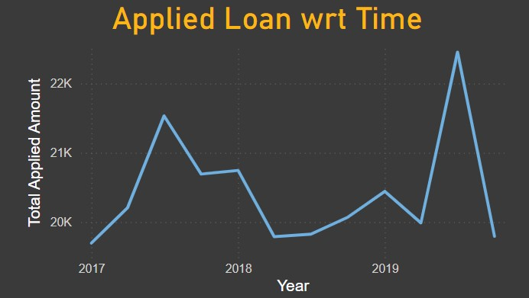
APPLIED LOAN TREND OVER TIME
The cha rt on the top (Ap
plied Loans over Time) shows a fluctuating trend in loan applications between 2017 and 2019.
There's a significant spike in 2019, where the total applied amount peaked.
The trend suggests growth in loan applications, possibly due to better customer engagement or marketing initiatives during that period.

Slide 4
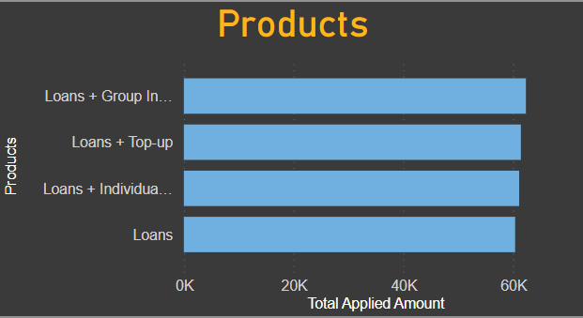
PRODUCTS-WISE LOAN APPLICATION
Here, Product loan is applied in the four categories are almost similar.
  Loans + Group Insurance
  Loans + Top up
  Loans + Individuals
  Loans
In the four categories, the highest loan applied are for Loan + Group Insurance which is almost 62K of the total loan applied.
The second highest is the Loans + Top ups which is almost 61K of the total applied loans, which is quite similar from the first highest.

Slide 5
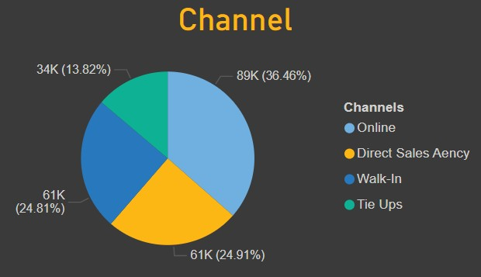
CHANNEL
The majority of loans are applied through the online channel (36.46%), followed by Direct Sales Agency (24.81%), Walk-In (24.91%), and Tie-Ups (13.82%).
Loans were distributed through four main channels:
• Online: 36.46% (89K)
  Direct Sales Agency: 24.81% (61K)
• Walk-In: 24.91% (61K)
• Tie-Ups: 13.82% (34K)
Online channels accounted for the highest loan applications, suggesting the importance of digital engagement for loan disbursement. Direct sales and walk- in channels also contributed significantly.

Slide 6
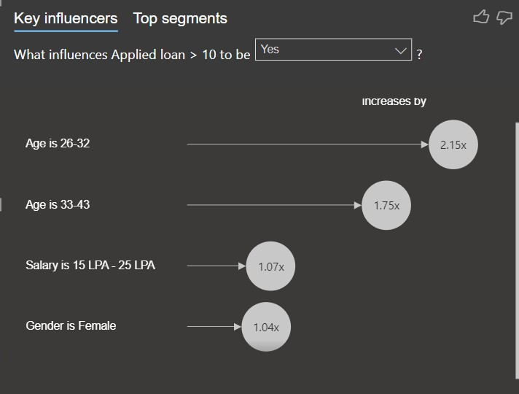
AGE ANALYSIS
According to the key influencers' section, applicants aged 26-32 are more likely to apply for loans above a certain threshold.
The likelihood of applying for higher loan amounts increases by 2.15 times for this age group.

Slide 7
OBSERVATIONS
A high percentage of loan applications get sanctioned and disbursed, with 87% and 80%, respectively. However, the recovery amount stands at 42.5%, indicating challenges in recovering disbursed loans. The bank might need to improve its loan recovery mechanisms to reduce outstanding debt.
The peak in 2019 suggests a growth in demand for loans, potentially due to new marketing strategies or an increase in customer engagement. This trend may indicate the bank's improved outreach or economic factors that led to higher loan applications.
The online channel is the leading source of loan applications, indicating that digital channels are becoming a preferred choice for customers. The bank should continue to strengthen its digital infrastructure and services to cater to this growing demand.
Group and top-up loans are the most widely applied products, indicating that customers prefer borrowing in groups or adding onto existing loans. This suggests the need for targeted marketing for these specific products and services.
Young adults in the 26-32 age group are more likely to take larger loans, which implies that the bank can tailor its products and marketing efforts to cater to the needs of this demographic.

